Slide 1

Database Systems Retrieval Queries in SQL ch4
CS 372
LAB 5

Slide 2

Lab objective
Arithmetic Operators
Logical Operator
AND & OR
NOT
Comparison Operator
BETWEEN
LIKE
IN
IS NULL

Slide 3

Arithmetic Operators
1

Slide 4
Arithmetic operators
Arithmetic operators can perform arithmetical operations on numeric operands.
Arithmetic operators is used on (Number and Date ) data type
Operator Precedence, Multiplication and division take priority over addition and subtraction.
Operators of the same priority are evaluated from left to right.
Parentheses are used to force priority

Slide 5
Arithmetic operators (Cont.)
Description | Operator
Add | +
Subtract | -
Multiply | *
Divide | /
SELECT column_name 1, …, column_name2 [arithmetic operator] column_name3,…
FROM [table_name]
Where the result will be new column for this operation

Slide 6
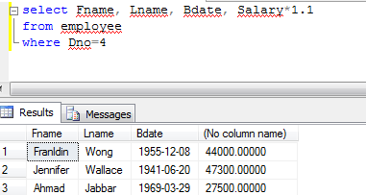
Arithmetic operators (Cont.)
Example 1: Based on employee, Show the resulting salaries if every employee working on the department number “4” is given a 1.1(110%)raise .

Slide 7
Arithmetic operators (Cont.)
Example 2: display the sub of price and discount for the products
which will be Less than or equal 200
Discount | Price | name | Product id
170 | 350 | T-shirt | 1234
200 | 400 | Skirt | 1235
300 | 600 | Dress | 1236
Product
SELECT product_id, name,price, discount, ( price – discount )
FROM products
WHERE (price –discount )<=200
Output
No column name | discount | Price | name | Product id
180 | 170 | 350 | T-shirt | 1234
200 | 200 | 400 | Skirt | 1235

Slide 8
Logical Operators
2

Slide 9
Logical Operators
There are three Logical Operators namely AND, OR, and NOT.
These operators compare two conditions at a time to determine whether a row can be selected for the output.
When retrieving data using a SELECT statement, you can use logical operators in the WHERE clause, which allows you to combine more than one condition.
It can use with all data types ( number, txt …etc).

Slide 10
Logical Operators
Meaning | Operator
Returns TRUE if both component conditions are TRUE | AND
Returns TRUE if either component condition is TRUE | OR
Returns TRUE if the following condition is FALSE | NOT

Slide 11

OR & AND

Slide 12
AND &OR
The SQL AND &OR clause is used when you want to specify more than one condition in your SQL WHERE clause.
SELECT column_name FROM table_name WHERE column_name with condition ( AND or OR ) column_name with condition

Slide 13
Example 1 : Retrieve the first name,last name and Address of all employees who work for Dnumber=4 and Dnumber=5
Select Fname, Lname, Address
From Employee
Where Dnumber=5 AND Dnumber=4

Slide 14
Example 2 : Retrieve the first name,last name and Address of all employees who work for Dnumber=4 or Dnumber=5
5
Select Fname, Lname, Address
From Employee
Where Dnumber=5 OR Dnumber=4

Slide 15
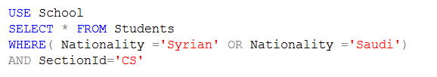

Use more than one condition
Example 3 : Display data from students table where Nationality is Syrian Or Saudi and Section Id is CS.

Slide 16
NOT

Slide 17
NOT
The logical operator NOT. NOT results in the reverse of a condition. That is, if a condition is satisfied, then the row is not returned
SELECT column_name(s) FROM table_name WHERE NOT (condition)

Slide 18
Example 1 : Retrieve all students whose do not play football.
SELECT first_name, last_name, games FROM student_details WHERE NOT( games = 'Football’)
Output
first_name | last_name | games
Rahul | Sharma | Cricket
Stephen | Fleming | Cricket
Shekar | Gowda | Badminton
Priya | Chandra | Chess

Slide 19
Combine more than one condition
Example 2 : Display the names, age and games of the of the students who age is between 10 and 15 years, or those who do not play football.
SELECT first_name, last_name, age, games FROM student_details WHERE age >= 10 AND age <= 15 OR NOT games = 'Football'
Output
first_name | last_name | age | games
Rahul | Sharma | 10 | Cricket
Priya | Chandra | 15 | Chess

Slide 20
Comparison Operators
3

Slide 21
Comparison Operators:
Meaning | Operator
Equal to | =
Greater than | >
Greater than or equal to | >=
Less than | <
Less than or equal to | <=
Not equal to | <>

Slide 22
Comparison Operators:
Comparison operators
Used in conditions that compare expression to another.
They are used in the WHERE clause in the following format:
WHERE expr operator value

Slide 23
Other Comparison Operators
There are other comparison keywords available in SQL which are used to enhance the search capabilities of a SQL query. They are "IN", "BETWEEN...AND", "IS NULL", "LIKE". It can use with all data types ( number, txt …etc).
Meaning | Operator
Between two values | BETWEEN .. AND..
Specify multiple values | IN (list)
Match a character pattern | LIKE
Is a null value | IS NULL

Slide 24
BETWEEN...AND

Slide 25
BETWEEN...AND
The BETWEEN operator selects a range of data between two values.
The values can be numbers, text, or dates ( all data type).
SELECT column_name(s) FROM table_name WHERE column_name BETWEEN value1 AND value2
(value 1 and value 2 will be included in the range )

Slide 26
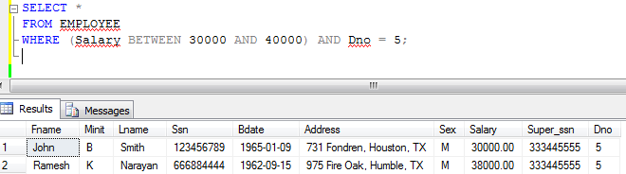
Use “Between” and “AND” operator
Example 1: Retrieve all employees in department 5 whose salary is between $30,000 and $40,000.

Slide 27
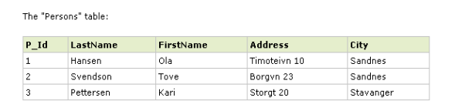
Example 2 :
Display all information of persons which their last name between 'Hansen' and 'Pettersen‘

Slide 28
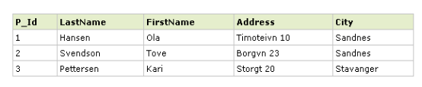
SELECT * FROM Persons WHERE LastName BETWEEN 'Hansen' AND 'Pettersen'

Slide 29
IN

Slide 30
IN
The IN operator is used when you want to compare a column with more than one value. It is similar to an OR condition
SELECT column_name(s) FROM table_name WHERE column_name IN (value1,value2,...)

Slide 31
IN (Cont…)
Differences between IN and OR
OR | IN
Use with more than one column with different data types and their different values | Use with one column and It’s different values
In both of them , there are comparison a column with values and choose all match records with these values

Slide 32
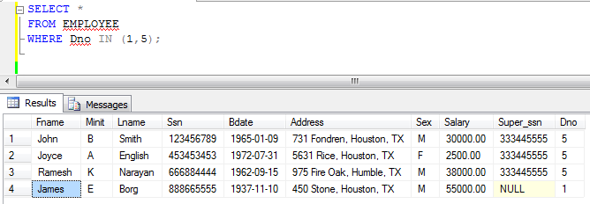
Example 1: Retrieve all employees whose Dno 1 or 5

Slide 33
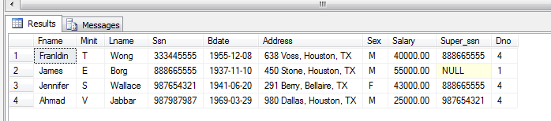
Combine more than one operators, EX: IN and NOT
Example : Retrieve all employees whose is not in Dno 5
We can use NOT IN or <> because its one value
SELECT * FROM Employee
WHERE Dno NOT IN ( 5 )
SELECT * FROM Employee
WHERE Dno<> 5

Slide 34
Combine more than one condition
Example 2 : Display the names, age and games of the students who age is between 10 and 15 years, or those who do not play football and basketball
SELECT first_name, last_name, age, games FROM student_details WHERE ( age >=10 AND age <= 15 ) OR (games NOT IN ('Footbal’, ‘basket ball’ ))
first_name | last_name | age | games
Rahul | Sharma | 10 | Cricket
Priya | Chandra | 15 | Chess
Joy | Lndi | 13 | Cricket

Slide 35
LIKE

Slide 36
LIKE
The SQL LIKE clause is very useful when you want to specify a search condition within your SQL WHERE clause, based on a part of a column contents.
SELECT column_name(s) FROM table_name WHERE column_name LIKE pattern

Slide 37
LIKE
‘_’ sign | ‘ % ‘ sign
can be used to define specific character in pattern | can be used to define wildcards (missing letters in the pattern)
Can use it before or after the pattern or both. | Can use it before or after the pattern or both.
It means single character (one character ). | It means one or more characters(no limit number of characters).

Slide 38
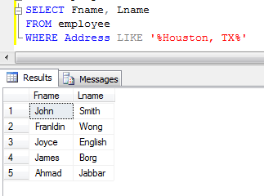
Example 1 : Retrieve names of all employees whose address is contain Houston, TX

Slide 39

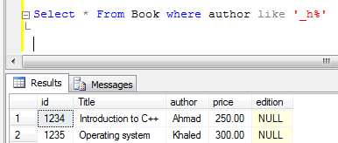
Example 2: Find names of authors which their second character is ‘h’

Slide 40
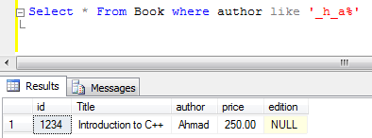
Example 3: Find names of authors which their second character is ‘h’ and fourth is ‘a’

Slide 41
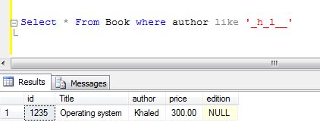
Example 4: Find the names of authors which their second character is ‘h’ , fourth is ‘l’ and its length is 6

Slide 42
Example 5 : Retrieve the persons living in a city that starts with "s" from the table above.

Slide 43
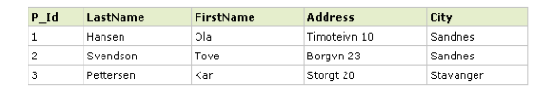
Example 5 : Retrieve the persons living in a city that starts with "s" from the table above.
SELECT * FROM Persons WHERE City LIKE 's%'

Slide 44
Example 6 : Retrieve the persons living in a city that ends with "s" from the table above.

Slide 45

SELECT * FROM Persons WHERE City LIKE '%s'

Slide 46
Example 7 : Retrieve the persons living in a city that contain the pattern "tav” from the table above.

Slide 47
SELECT * FROM Persons WHERE City LIKE ‘%tav%'

Slide 48
IS NULL

Slide 49
IS NULL
A column value is NULL if it does not exist. The IS NULL operator is used to display all the rows for columns that do not have a value.
SELECT column_name(s) FROM table_name WHERE column_name IS NULL

Slide 50
Example 1 : Retrieve the persons names and address for who's doesn’t have address
P_Id | LastName | FirstName | Address1 | City
1 | Hansen | Ola |  | Sandnes
2 | Svendson | Tove | Borgvn 23 | Sandnes
3 | Pettersen | Kari |  | Stavanger

Slide 51
SELECT LastName,FirstName,Address1
FROM Persons WHERE Address1 IS NULL
LastName | FirstName | Address1
Hansen | Ola
Pettersen | Kari

Slide 52
Exercise
1.Create a data base (company_lab5)
2.Create the following table:
employee_no | e_name | Salary | phone
1456 | Ahmad | 4000 | 0555558888
1457 | Khaled | 4500 | null
1458 | Ahmad | 3000 | 0555553333
1459 | Mohamed | 6000 | 0555555777

Slide 53
Exercise
3. Select all records from Employee table which their name is ‘Ahamd’ and their salary is 4000.
4. Show the resulting of Adding 2000 for salary to all employees their name is end with 'd’.
5. Retrieve employee no and name where employee name contain 'ma‘.
6. Retrieve all information for employees between ‘Khaled’ and ‘Mohamed’ and haven't phone number

